Slide 1
CVV
Group 5
SMARTLAB GUARDIAN
smart Computer Laboratory Management & Monitoring System
Group members
Supervisor:
Ms. S. Bramyah Lecturer(Probationary)
2022/ICT/36
2022/ICT/52
2022/ICT/126
2022/ICT/135
2022/ICT/141
2022/ICT/128

Slide 2
INTRODUCTION
Why our university labs need a smarter system
Fake logins
Slow exam setup
Missing hardware
Students sometimes log in using a friend's account. It's hard to know who really did the work.
Assigning students to computers by hand can take 45 minutes or more.
Keyboards, mice, and monitors can go missing without anyone noticing right away.

Slide 3

BACKGROUND & EXISTING SYSTEM
•Our university uses Classroom Spy to view student screens during practicals.
•Exam computer assignment is still done by hand, using printed sheets.
•A disconnected device doesn't raise any alert on its own.
•Login activity, usage, and hardware records live in different places

Slide 4
WITH SMARTLAB GUARDIAN
Compares login details with real activity to catch identity misuse.
Sends an instant alert the moment a device is removed.
Imports an Excel sheet and auto-assigns students to computers in minutes
Puts logins, usage, and hardware in a single dashboard.
Keeps one central record for every keyboard, mouse, monitor, and cable.

Slide 5
ROLES IN THE SYSTEM
Admin
Student
Examiner
Manages students database, hardware database, alerts, and reports.
Logs into the assigned lab computer for class or exams
Sets up exams and checks computer assignments.
Lecturer
Start session,End session and
view Attendance report

Slide 6

KEY FEATURES
•Checks logins against real computer activity
•Imports Excel data to auto-assign exam seats
•Tracks hardware condition, location, and status
•Alerts admin the moment a device is removed

Slide 7
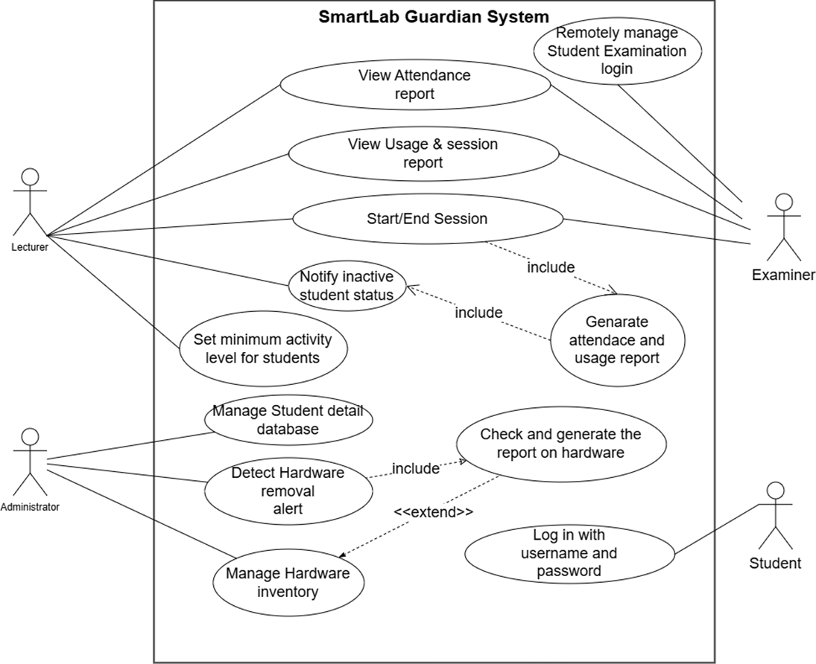
MATERIALS & METHODS

Slide 8
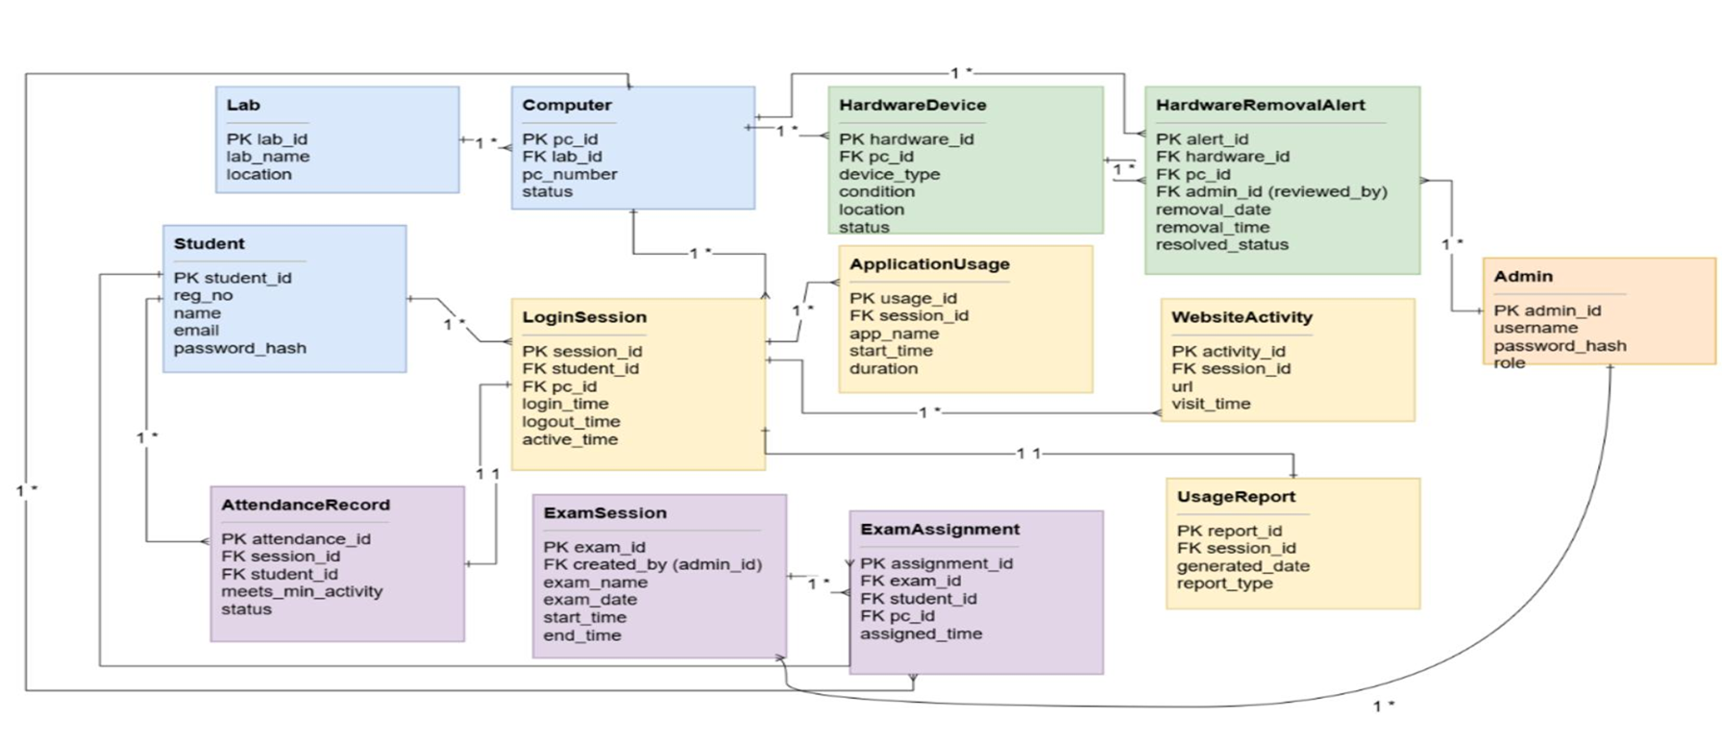
MATERIALS & METHODS

Slide 9

TOOLS & TECHNOLOGIES
Backend
Node.js, Express.js
Version Control
Git & GitHub
Frontend
React.js, HTML/CSS/JS
Other
Postman, VS Code
Database
MongoDB Atlas

Slide 10
EXPECTED RESULTS
Working prototype
Fast exam setup
Login checks
Tested on a group of lab computers, built to scale to the whole lab.
Assigns students and computers in a few minutes, not 45+.
Flags accounts that show activity that doesn't match the student.
Hardware alerts
Usage reports
One dashboard
Notifies admin the moment a device is disconnected
Shows attendance, active time, and app usage per student.
Brings monitoring, hardware, and reports into a single screen

Slide 11

PROJECT TIMELINE
Weeks 1–3
Weeks 4–8
Research & Design
Build the System
Study existing systems, plan the database, and design the use cases
Develop monitoring, dashboard, backend, and hardware alerts
Weeks 9–10
Weeks 11–12
Testing
Wrap Up
Connect all parts and test the full system together.
Write the report and prepare the final submission.

Slide 12


REFERENCES & GITHUB REPOSITORY
Repository:
https://github.com/RaneemaRisnee/SmartLab-Guardian
References:
1.https://classroomspy.com/
2. Python socket network programming - Yasoob Khalid
3.Build a Simple File Transfer System Using Python (Network Programming Project) | by Nathan Chiche | Medium
4.How to Choose a Tech Stack in the AI Era - Full Scale

Slide 13
THANK YOU
Question & Awnsers
SmartLab Guardian — Group 05 • IT3162 Group Project •University of Vavuniya

